Slide 1
StartCHAIN :
A Crowdfunding Platform using Blockchain
- By Palak Savlia (KJSCE)

Slide 2

Problem Definition
With entrepreneurs unable to receive capital from banks due to high risk of failure of their startup/ project ideas, crowdfunding (started in 2012) emerged as a new source for raising funds and gained popularity in very less span of time.
Many crowdfunding platform have been developed
since then, however these platforms have some
drawbacks such as :
1) High Fees 2) Mediators 3) Blind Trust
4) Repudiation 5) No system transparency
To overcome these issues, we will provide a platform
for crowdfunding using blockchain.
The platform will have features such as transparency,
high security, speedy transactions and non-repudiation.
Thus, we aim to build a trustworthy network and
promote crowdfunding.

Slide 3
Functional Requirement
Non-Functional Requirement
User Registration
User Login
Search Campaign
Create Campaign
Fund Campaign
Availability
Portability
Performance
Usability
Security
Technologies Used
MultiChain - Open source Blockchain Platform
AWS - Amazon Web Services
MySQL - Open source Relational Database Management System

Slide 4
Literature Survey
In less than a decade, crowdfunding has gained traction in many developed economics including Australia, United Kingdom, Netherland, Italy, and the United States.
Realising the growth of crowdfunding in the world and in India, fund raising through contributions from public through internet based platforms is relatively an innovative concept.
India is a huge market with Global business and investment opportunities which shows the possibilities for growing an infant industry to a large scale through crowdfunding.
Crowdfunding is not a fundraising method that replaces all the traditional funding techniques in India but it is best to think of it as simply a new method of obtaining funding and should be evaluated in light of other alternatives that are available.

Slide 5
The Existing Web-based Platforms
Advantages | Disadvantages
Wide base of global investors to the startup | Intermediaries may shut down portal
It doubles as marketing and media exposure | Failing to complete target will result in returning all your funds to your investors
Provides base for small enterprise to enter the market | Legal issues & cyber crimes
Get continuous feedback and expert guidance | No transparency, No trust, Not highly secure and Repudiation

Slide 6
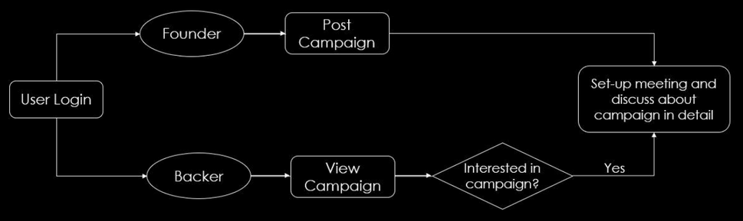
Implementation : Phase I
Phase I : Backer-Founder agreement for a particular campaign

Slide 7
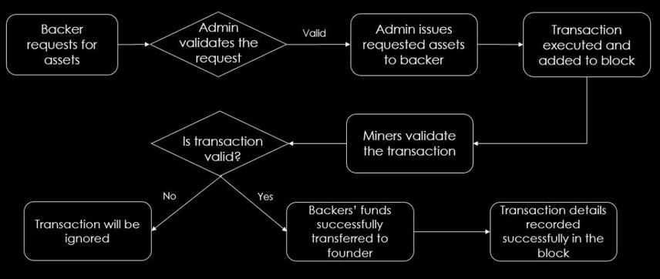
Implementation : Phase II
Phase I : Backer-Founder agreement for a particular campaign
Phase II : Transfer of funds from the backer to the founder

Slide 8
Implementation Steps
Created 3 primary nodes on AWS Cloud : Admin, Founder and Backer.
Connecting each node with the chain created so that all the transactions can be recorded successfully.
The main feature of Multichain used in the project is ‘STREAMS’.
A stream can be viewed as an append-only database.
Admin’s Role : The assets in backer’s account are all granted by the admin. Basically, the admin acts as a financial manager in the project.
Founder’s Role : Created a create campaign page for founder which technically corresponds to stream creation of multichain. The founder is subscribed to the stream automatically.
Backer’s Role : When a Backer wants to fund a campaign it simply initiates the transaction by searching the campaign and confirming the presence of the required amount in his account. The interested backers are by default subscribed to the campaign, i.e stream, in order to make changes on that particular stream in the form of funds transfer.

Slide 9
Conclusion
StartCHAIN will turn out to be innovative source of funding for the budding entrepreneurs in India.
This platform sets an example of an easy, convenient and time saving medium of raising funds from the global investors by eliminating the disadvantages of the existing web-based crowdfunding platforms in India.
Focusing on the core features of Multichain, we believe that blockchain technology has high value and good prospects in resolving the problems of crowdfunding and optimizing its process.
Besides this, Multichain platform offers a more secure, efficient, and low cost solution in establishing a private reliable connection between the founders and stakeholders ignoring any geographical limitations.
Thus, a peer-to-peer architecture supported Multichain platform provides secure electronic transactions, significantly simplifying the process of transaction and transfer. This will surely facilitate the fund circulation, activate and boost the crowdfunding market in India.

Slide 10
References
K.Neelavathi and Swetha Chavali, “A Study on Crowd Funding as a new concept of raising capital”, IOSR Journal of Business and Management, International Conference on Paradigm Shift in Taxation, Accounting, Finance and Insurance, 2017.
Jhaveri, Hetal & Choksi, Anjali,“CROWDFUNDING AT INDIA: A STUDY OF INDIAN ONLINE CROWDFUNDING PLATFORMS.”, IFRSA BUSINESS REVIEW, 2014.
Zhiyuan TIAN, Lei GUAN & MeilinSHI,“The Key Factors of Successful Internet Crowdfunding Projects – An Empirical Study Based on Different Platforms”, 1109/ICSSSM, 2018.
Dr. Manoj Kumar Joshi, “Crowdfunding For Startups in India”, aWEshkar Vol. XXIV Issue 1, March 2018. Satoshi Nakamoto, “Bitcoin: A Peer-to-Peer Electronic Cash System”, www.bitcoin.org, 2008.
Zibin Zheng, Shaoan Xie, Hongning Dai, Xiangping Chen and Huaimin Wang, “An Overview of Blockchain Technology: Architecture, Consensus, and Future Trends”, 2017 IEEE 6th International Congress on Big Data, IEEE Computer Society.
Supriya Thakur Aras and Vrushali Kulkarni, “Blockchain and Its Applications – A Detailed Survey”, International Journal of Computer Applications (0975 – 8887), Volume 180 – No.3, December 2017.

Slide 11
References (Continued)
Gebert, Michael, “APPLICATION OF BLOCKCHAIN TECHNOLOGY IN CROWDFUNDING”, New European Newspaper Article, 2017.
Huasheng Zhu and Zach Zhizhong Zhou, “Analysis and outlook of applications of blockchain technology to equitycrowdfunding in China”, Zhu and ZhouFinancial Innovation, 2016.
Acorn, “Acorn Collective: The First Completely Free and Open-Access Blockchain Crowdfunding Platform”, Whitepaper, January 2018.
Dr Gideon Greenspan, “MultiChain Private Blockchain — White Paper”, 2015.
https://www.thebalance.com/how-bitcoin-and-blockchain-is-changingcrowdfunding-4173837
https://www.disruptordaily.com/blockchain-use-cases-crowdfunding/
https://www.ibm.com/blogs/blockchain/2019/10/the-future-is-crowdfunded/

